Slide 1
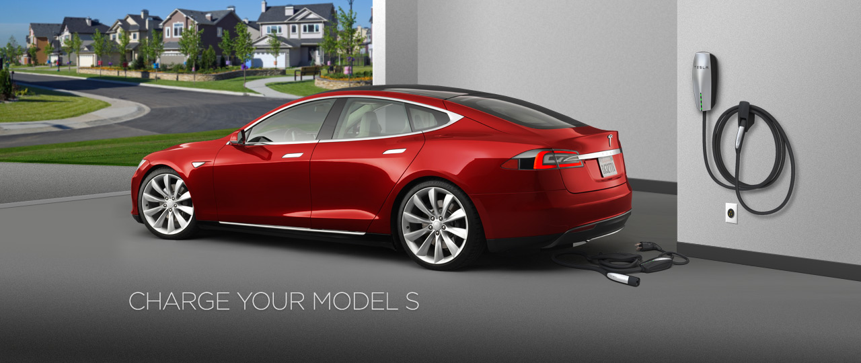
Smart Microgrid with Electric Vehicles
Modelling and Simulating
Social Systems with MATLAB
14 December 2015
XINGLIANG FANG
SEOHO JUNG
HUITING ZHANG

Slide 2
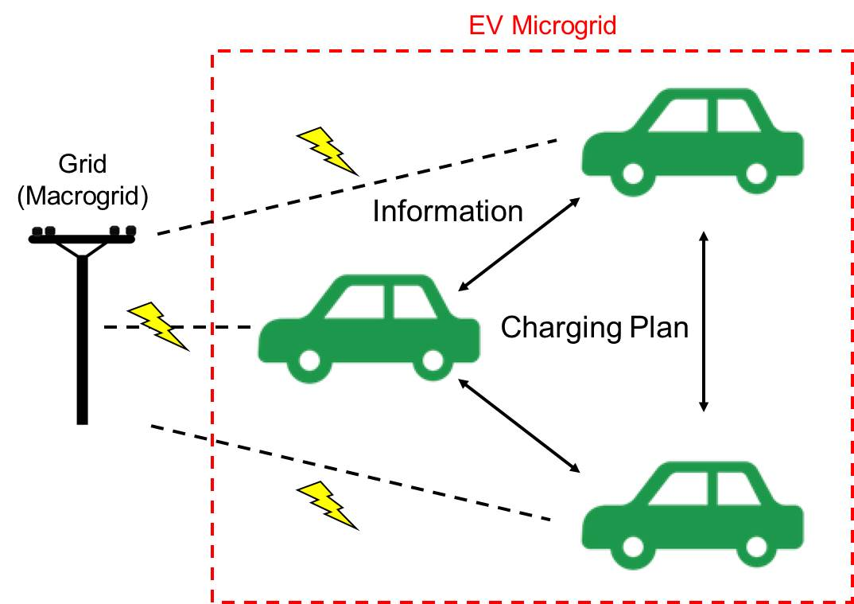
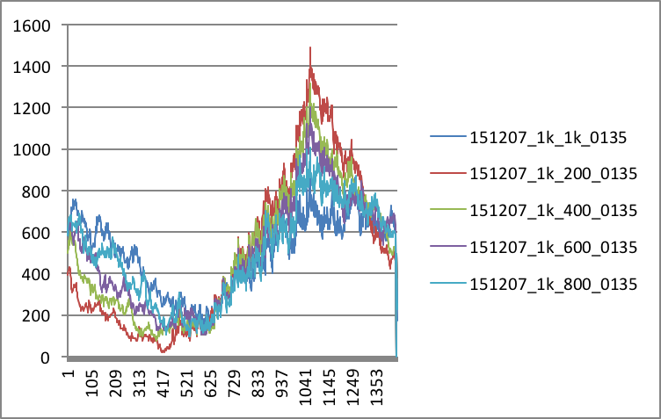

PRESENTATION OVERVIEW
1. Model
3. Results and Discussion
2. Implementation
Improved Grid Robustness
Reduced Cost
- Driving Profile
- SOC
- Power
- Cost

Slide 3
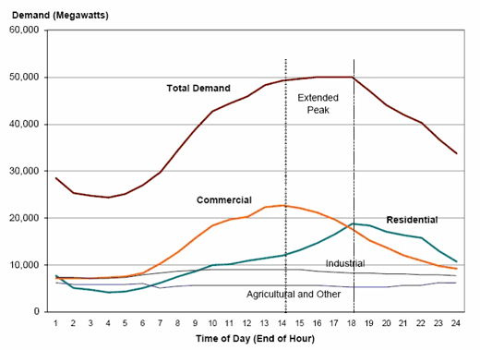
INTRODUCTION
Expected to increase due to EV charging
Solutions
Increasing generation
-> Underutilization of Facilities
Managing demand effectively
Notes:
Power consumption during evening hours is expected to be high, while that is early morning between 2 AM and 6 AM is low because all vehicles are already fully charged.

Slide 4
MODEL
EV Agent Model
Every EV receives a charging plan from EV agent
Our interests
: alleviating peak load by shifting power consumption of some EVs (improving grid robustness)
: reducing cost of charging
Assumptions
EVs only charge at home
All vehicles are Tesla Model S (2015 85D)
Our analysis is based on electricity pricing and driving profile in Texas

Slide 5
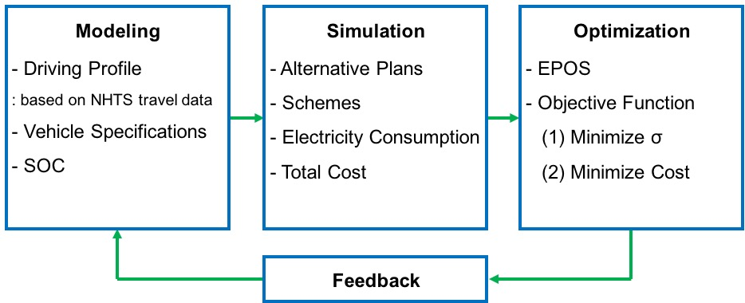
IMPLEMENTATION

Slide 6
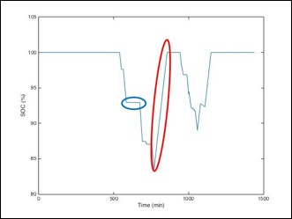
IMPLEMENTATION

Slide 7
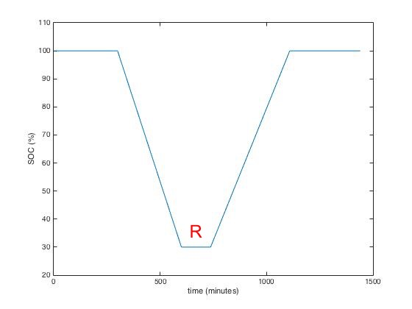
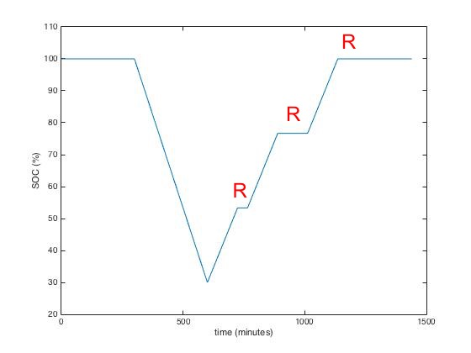
ALTERNATIVE PLANS
 | Start | Number of Steps
Original Plan | Immediate | 1
Alternative Plan 1 | Random | 1
Alternative Plan 2 | Immediate | 2
Alternative Plan 3 | Random | 2
Alternative Plan 4 | Immediate | 3
Alternative Plan 5 | Random | 3

Slide 8
RESULTS: PRELIMINARY EXPERIMENT
Original
Peak - Valley
-> Robustness of the grid
Off-Peak Pricing
-> Cost for the customers
Diurnal Driving

Slide 9
RESULTS: PRELIMINARY EXPERIMENT
Results
Optimization for Robustness
Scheme 1 (0,1,1,1)
: AP1 most effective
Schemes 2 (0,2,2,2)
and 3 (0,4,4,4)
: Improvement expected
if first steps determined
randomly
Optimization for cost
Plan | Start | Steps
0 | Immediate | 1
1 | Random | 1
2 | Immediate | 2
4 | Immediate | 3

Slide 10
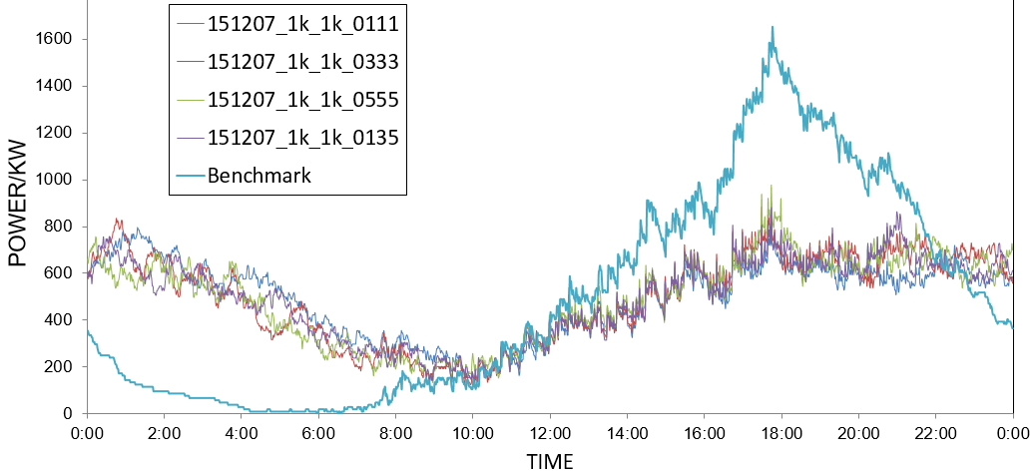
RESULTS: IMPROVING ROBUSTNESS
 | Start | Steps
Benchmark | Immediate | 1
Alternative Plan 1 | Random | 1
Alternative Plan 3 | Random | 2
Alternative Plan 5 | Random | 3
All four schemes with alternative plans can significantly improve robustness throughout the day
The number of charging steps in alternative charging plans does not make significant differences
Benchmark
With different schemes

Slide 11
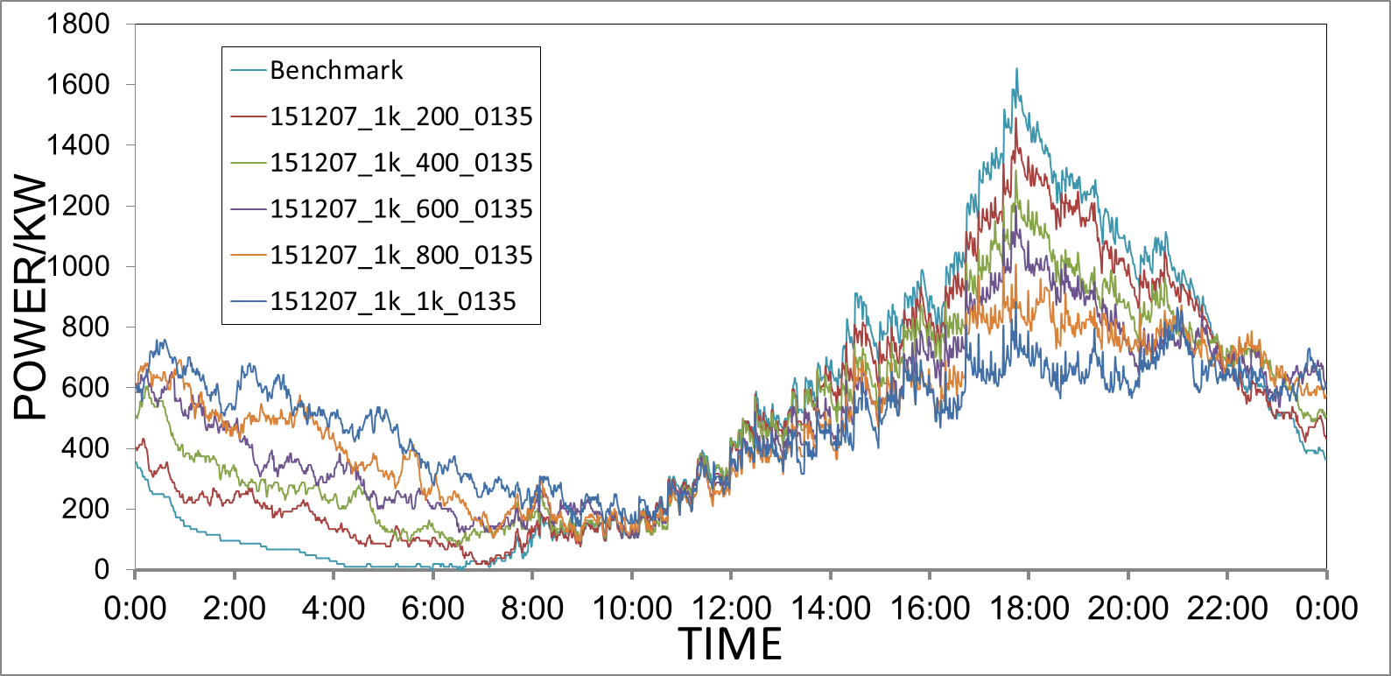
RESULTS: IMPROVING ROBUSTNESS
Experiment Variables | Values
Number of “Flexible” EVs | 0%, 20%, 40%, 60%, 80%, 100%
Scheme | [0, 1, 3, 5]
(c) The more EVs accept alternative plans, the more robust the grid becomes

Slide 12
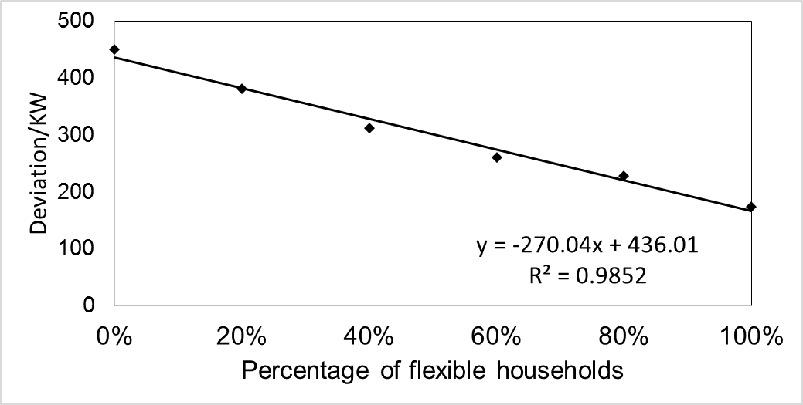
RESULTS: IMPROVING ROBUSTNESS
(d) The grid robustness, measured in standard deviation, has a negative near-linear correlation with the percentage of flexible EVs

Slide 13
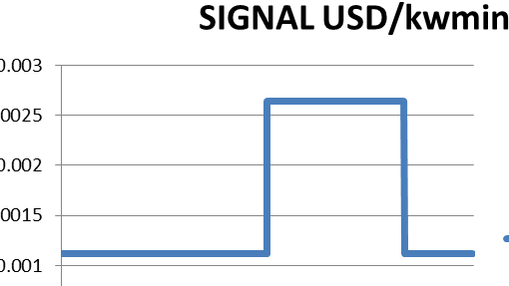
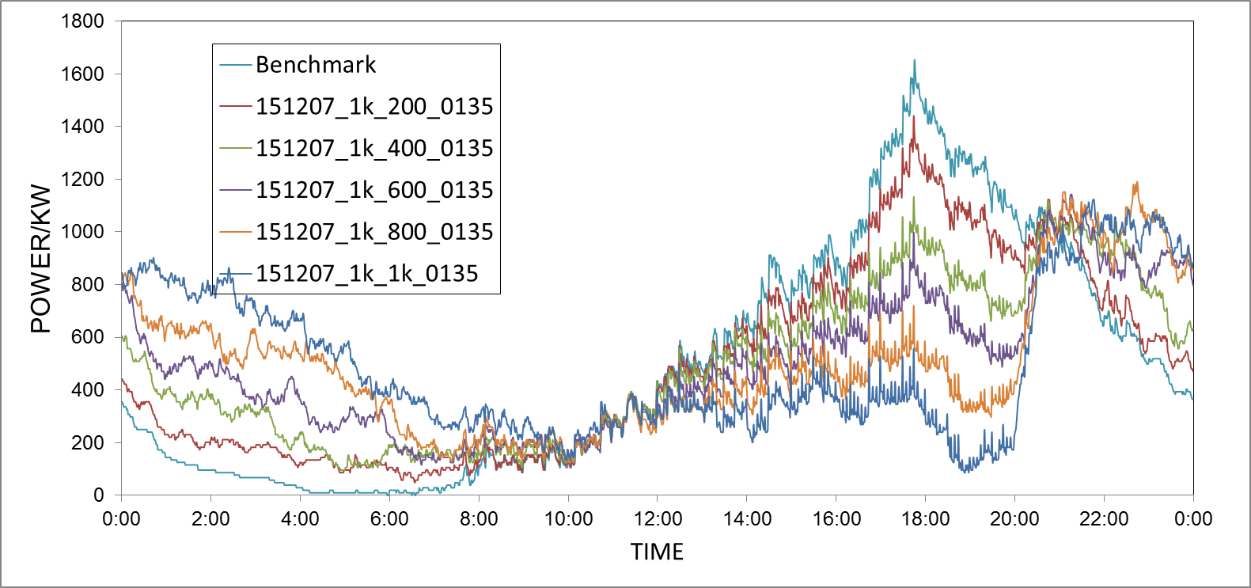
RESULTS: MINIMIZING COST
Cost decreases as optimization is performed. (32.6% cost saved, when best and worse cases are compared)
The higher the percentage of flexible EVs, the lower the total cost
0 | ($ 1,494.42)
0.2 | ($ 1,406.21)
0.4 | ($ 1,301.65)
0.6 | ($ 1,215.60)
0.8 | ($ 1,112.46)
1 | ($ 1,022.35)
1494.42 USD
1022.35 USD

Slide 14
RESULTS: MINIMIZING COST
(c) Cost minimization has an impact on grid robustness
! Can be a positive influence
! Can be a negative effect (when too many EVs participate)
Flexibility | 0% (benchmark) | 20% | 40% | 60% | 80% | 100%
Average/KW | 496.037804 | 495.924392 | 495.804309 | 495.644197 | 495.597498 | 495.55747
SDV/KW | 450.0195038 | 366.037821 | 295.897607 | 255.979446 | 259.316847 | 277.148421

Slide 15
SUMMARY AND OUTLOOK
Conclusion
Our smart microgrid improves grid robustness significantly by assigning alternative charging plans to EVs
As more EVs participate,
(2) Robustness ↑
(3) Total energy cost ↓, but robustness might ↓
Outlook
Optimization of both cost and robustness
Easy execution in real life

Slide 16
REFERENCES
[1] Image on Page 1: https://www.teslamotors.com/model-charging
[2] Power consumption graph on Page 3: R. E. Brown, J. G. Koomey, Electricity Use in California: Past Trends and Present Usage Patterns (2002)

